Slide 1
Photomicrographs of Plant foods
Parsley
Permission to reproduce original photomicrographs used to make this collection may be obtained from
Dr. David O. Norris at
david.norris@colorado.edu

Slide 2
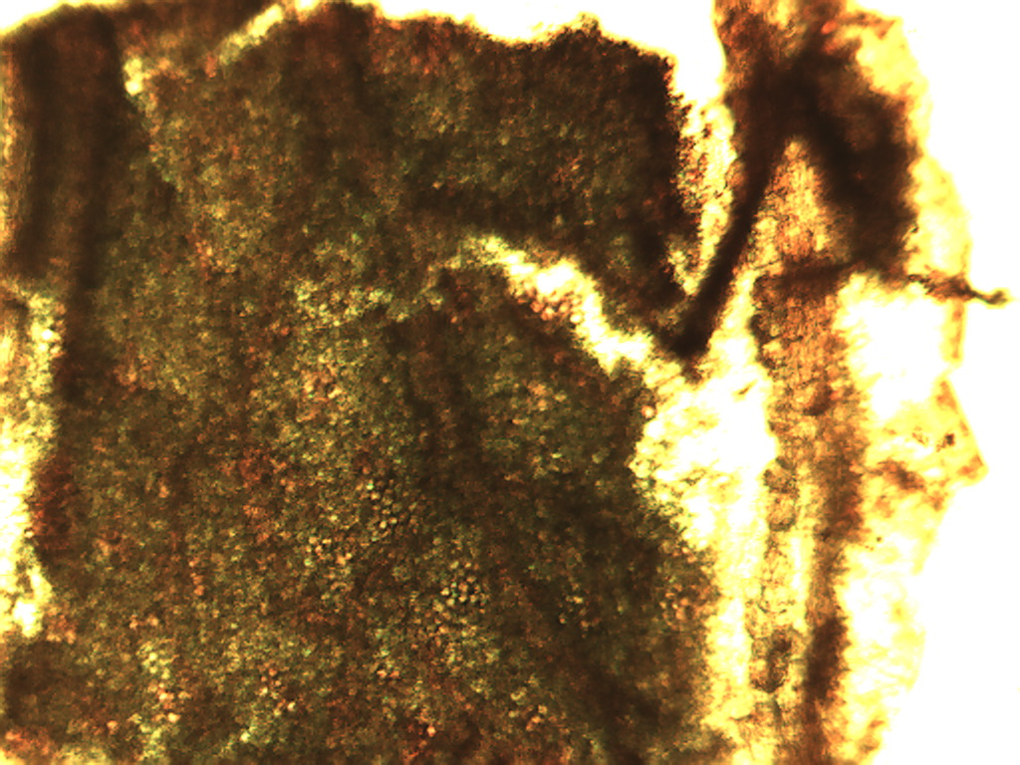
Notes:
327. Petroselinum crusoum (Mill.) Fuss. Parsley. Leaf surface, 4X

Slide 3
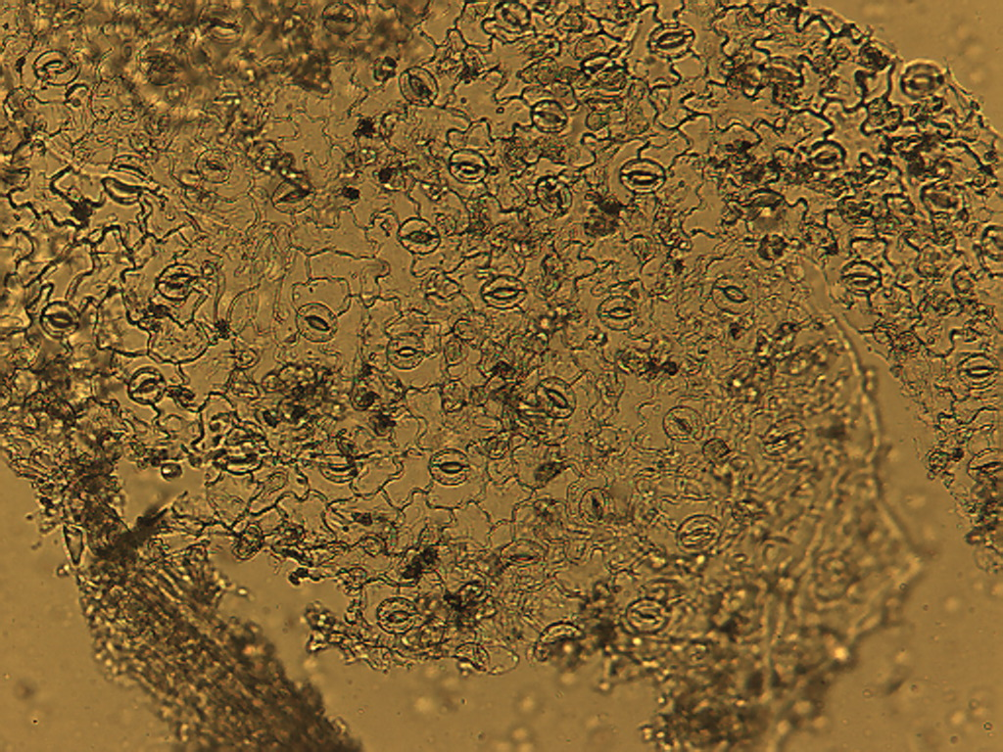
Notes:
328. Parsley. Puzzle-like epidermal cells with numerous stomates (arrows), 10X

Slide 4
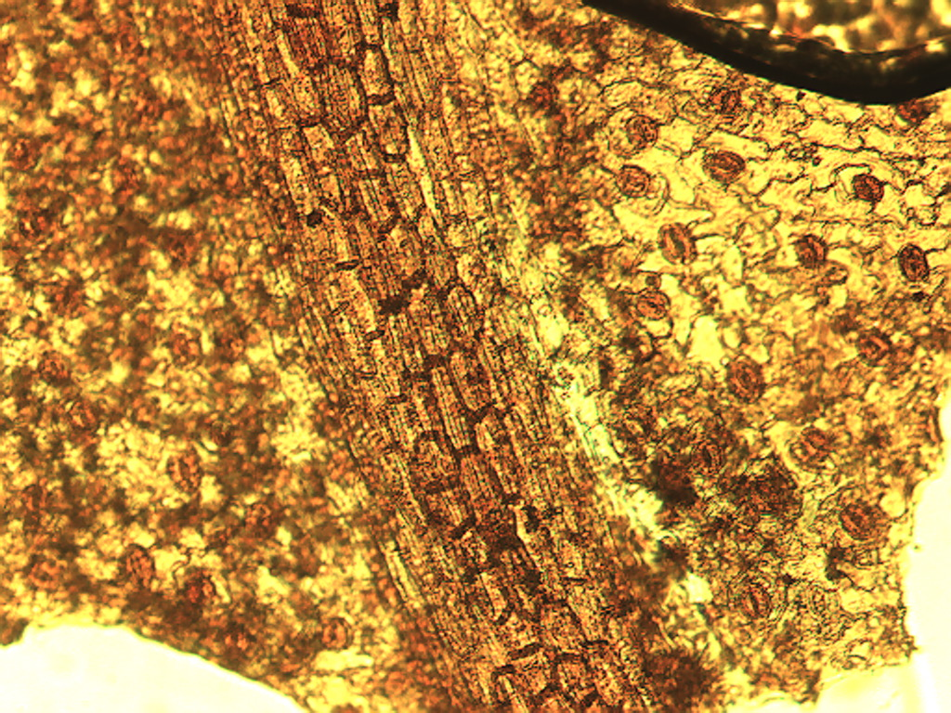
Notes:
329. Parsley. Leaf stained with safranin showing photosynthetic parenchyma (left), vascular cells in a vein (central) and epidermal cells with stomata (right), 10X

Slide 5
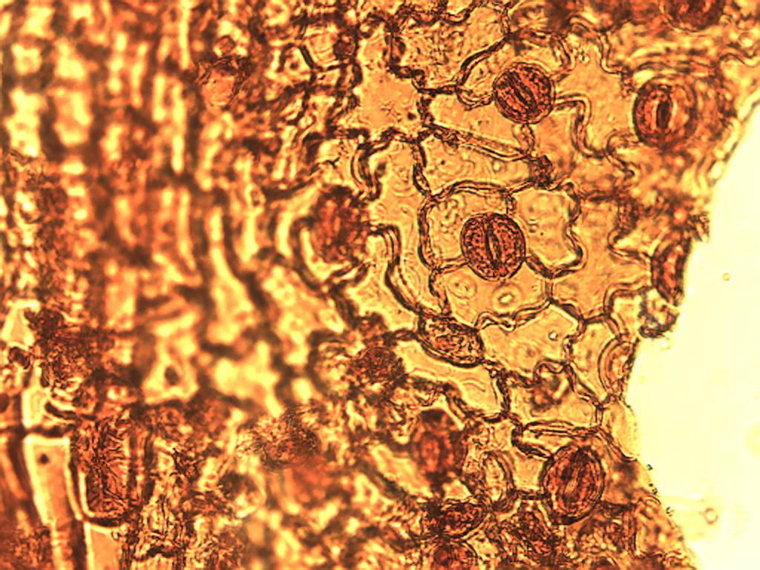
Notes:
330. Parsley. Epidermis with stomates (arrows), stained with safranin, 25X

Slide 6
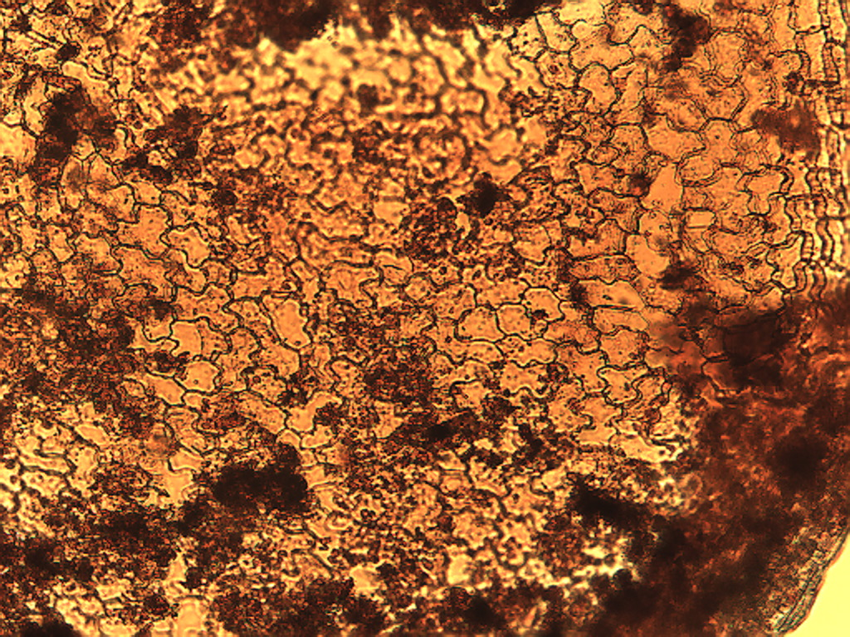
Notes:
331. Parsley. Epidermis region lacking stomates, stained with safranin,10X.

Slide 7
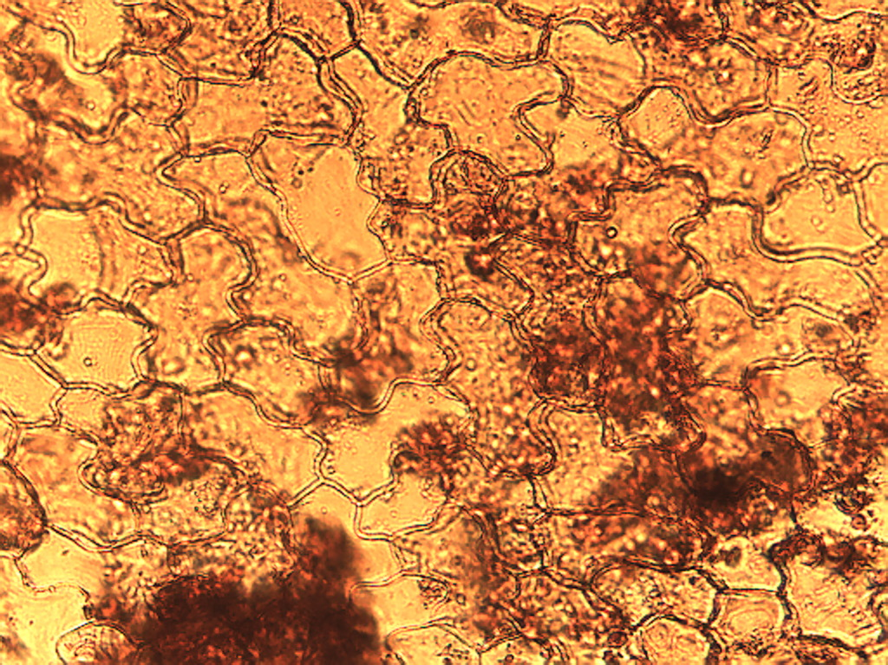
Notes:
332. Parsley. Epidermal cells without associated stomates, stained with safranin, 25X.

Slide 8
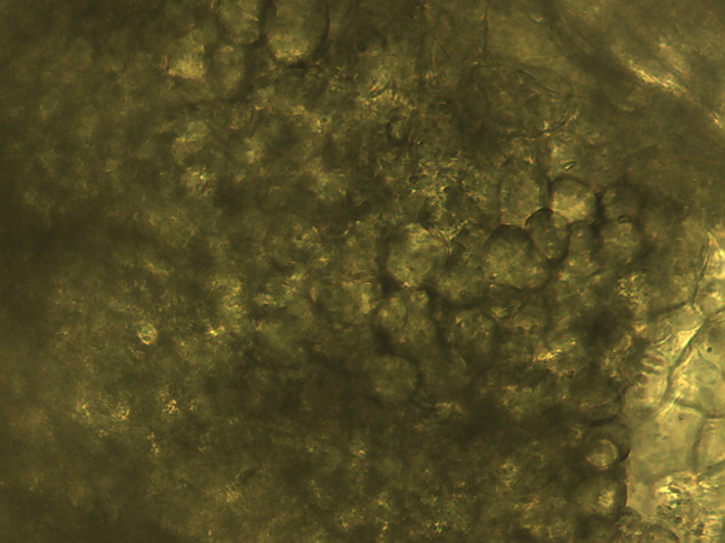
Notes:
333. Parsley. Photosynthetic parenchymal cells, 25X

